Slide 1

Exploratory Data Analysis on AMCAT Dataset
- RAJU LAKKARSU

Slide 2
About me
Background:
I am L Raju holding Degree in BSc.(MPCS) graduate with a strong interest in Computer knowledge AI and Robotics.
Motivation for Data Science:
Following graduation, I found myself drawn to the world of Artificial Intelligence. Intrigued, I embarked on a journey of exploration, seeking the right path to align with my interests. Through research and introspection, I discovered that Data Science resonates deeply with me, offering a perfect fit for my aspirations and skills.
Work Experience:
I am Currently interning at Innomatics Research Labs, transitioning from a mechanical engineering background to data science.
LinkedIn: https://www.linkedin.com/in/raju-lakkarsu-7b541b253/
GitHub: https://github.com/lakkarsuraju

Slide 3
Agenda (This should be the PPT flow)
Business Problem and Use case domain understanding(If Required)
Objective of the Project
Web Scraping – Details (Websites, Processor you followed)
Summary of the Data
Exploratory Data Analysis:
Data Cleaning Steps
Data Manipulation Steps
Univariate Analysis Steps
Bivariate Analysis Steps
.
Key Business Question
Conclusion (Key finding overall)
Q&A Slide
Your Experience/Challenges working on Web Scraping – Data Analysis Project.

Slide 4
Business Problem Statement:
Objective of the Project:
Exploratory Data Analysis (EDA):
Analyzing distributions of variables.
Investigating relationships between variables.
Research Questions:
Testing salary claim.
Exploring gender-specialization relationship.
Conclusion:
Summarizing key findings.
Providing recommendations.
The objective of the project is to conduct exploratory
data analysis (EDA) on the Aspiring Minds
Employment Outcome 2015 (AMEO) dataset to:
Gain insights into the employment outcomes of engineering graduates.
Understand the factors influencing salary expectations and
specialization preferences among graduates.
Provide recommendations for optimizing recruitment strategies and improving graduate outcomes based on data- driven insights.

Slide 5
Description:
The dataset contains information on 3,998 individuals, spanning across 39 columns. Each row represents a unique individual, while each column provides specific details about their employment and educational background.
Key columns include:
• ID: Unique identifier for each individual.
• Salary: The salary earned by the individual.
• DOJ: Date of joining the organization.
• DOL: Date of leaving the organization.
• Designation: Job title or position held.
• Job City: City where the job is located.
• Gender: Gender of the individual.
• DOB: Date of birth.
• 10percentage: Percentage obtained in 10th grade.
• 10board: Board of education for 10th grade.
• 12graduation: Year of graduation from 12th grade.
• 12percentage: Percentage obtained in 12th grade.

Slide 6
Description:
• 12board: Board of education for 12th grade.
• College ID: Unique identifier for the college.
• College Tier: Tier of the college.
• Degree: Degree obtained.
• Specialization: Field of specialization.
• college GPA: GPA obtained in college.
• College CityID: Unique identifier for the college city.
• College CityTier: Tier of the college city.
• College State: State where the college is located.
• Graduation Year: Year of graduation from college.
• English, Logical, Quant: Scores obtained in respective subjects.
• Domain: Domain knowledge score.
• Computer Programming, Electronics And Semicon, Computer Science, Mechanical Engg, Electrical Engg, Telecom Engg, Civil Engg: Scores or qualifications in various engineering disciplines.
• conscientiousness, agreeableness, extraversion, neuroticism, openess_to_experience: Personality trait scores.
• The dataset offers a rich source of information for exploring employment outcomes, educational backgrounds, and personality traits among engineering graduates. With a diverse range of variables, it provides ample opportunities for in-depth analysis and insights into factors influencing career trajectories.

Slide 7
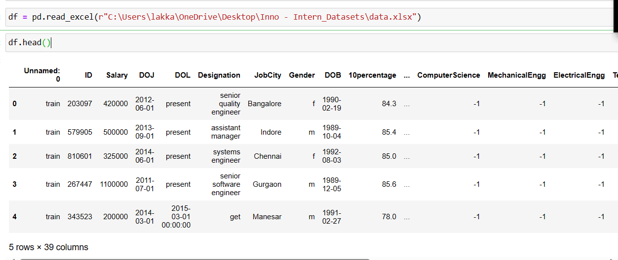
Raw Data:

Slide 8
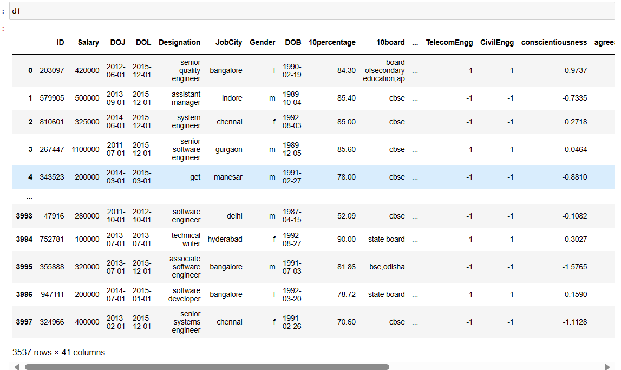
Cleaned Data:

Slide 9
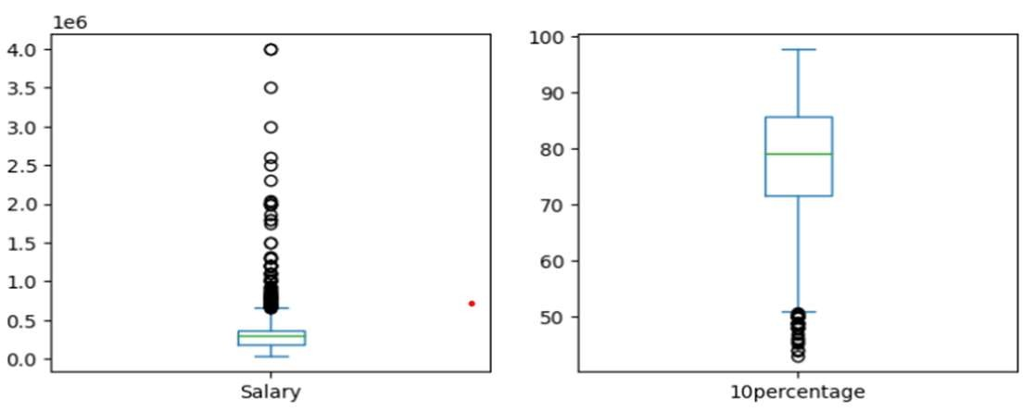
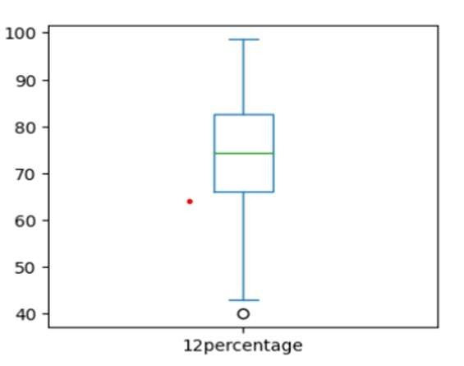
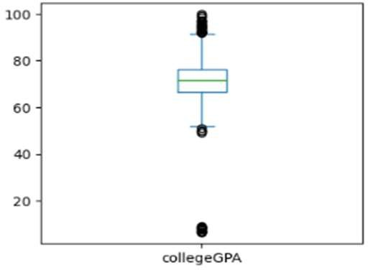
Univariate - Numerical Analysis
Salary:
Salary has a wide range of values, with the minimum salary being $35,000 and the maximum being $4,000,000.
The mean salary is approximately $307,700, with a median of $300,000, indicating a positively skewed distribution.
10th Percentage:
10th percentage ranges from 43% to 97.76%, with a mean of approximately 77.93% and a median of 79.15%.
Overall, the distribution seems relatively symmetric and centered around the mean.
12th Percentage:
12th percentage varies from 40% to 98.7%, with a mean of approximately 74.47% and a median of 74.4%.
The distribution appears to be approximately symmetric (skew = -0.03) with minimal kurtosis (kurt = -0.63).
College GPA:
College GPA ranges from 6.45 to 99.93, with a mean GPA of approximately 71.49 and a median of 71.72.
The distribution is negatively skewed (skew = -1.25) and exhibits high positive kurtosis (kurt = 10.23), indicating a significant departure from normality.

Slide 10
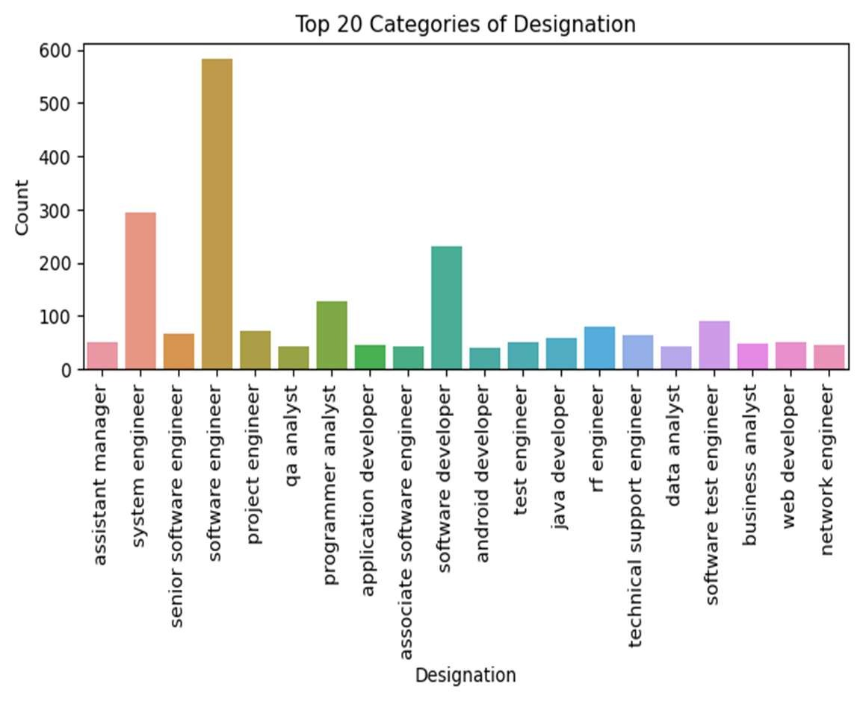
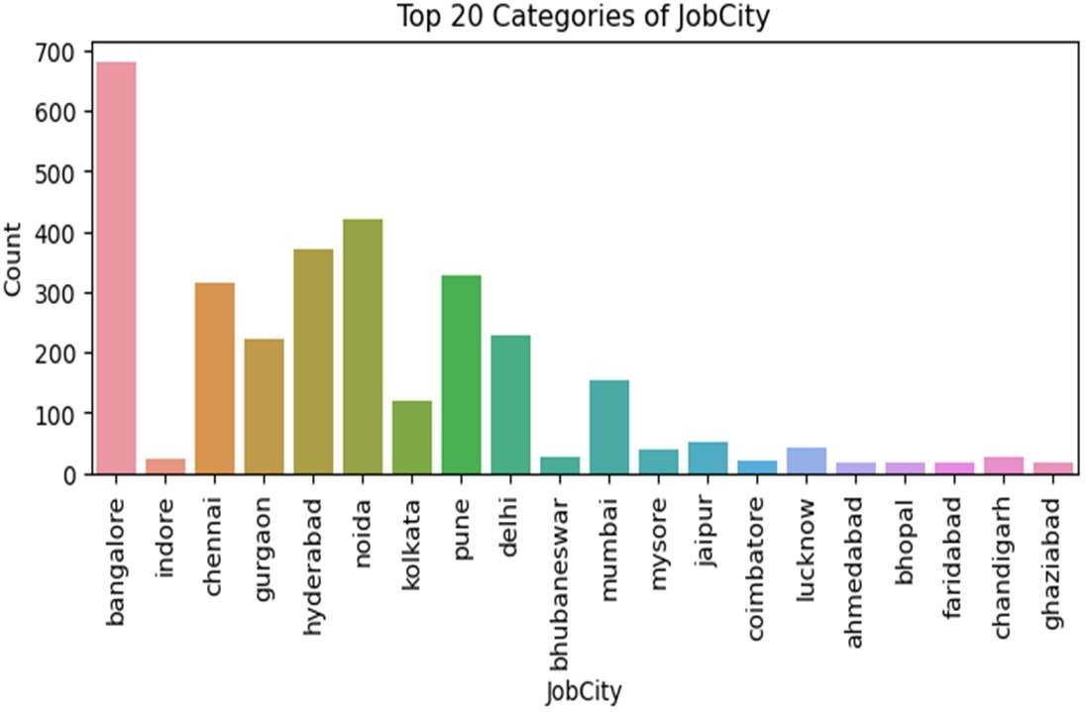
Univariate - Categorical Analysis
Among the dataset's job titles or roles, the most frequent designation is 'Software Engineer', with a count ranging from 500 to 600. Conversely, ‘android developer' and ‘data analyst have the lowest counts compared to other designations.
Regarding job locations, the highest count of jobs is observed in Bangalore, ranging from approximately 600 to 700. Conversely, Bhopal, gaziabad, farindabad, Ahmedabad & coimbatore has the lowest count of jobs compared to other cities.

Slide 11
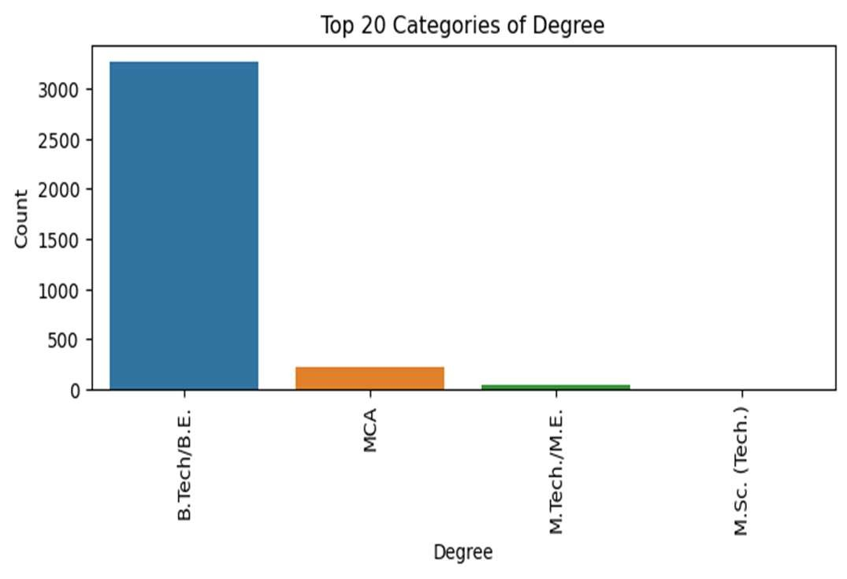
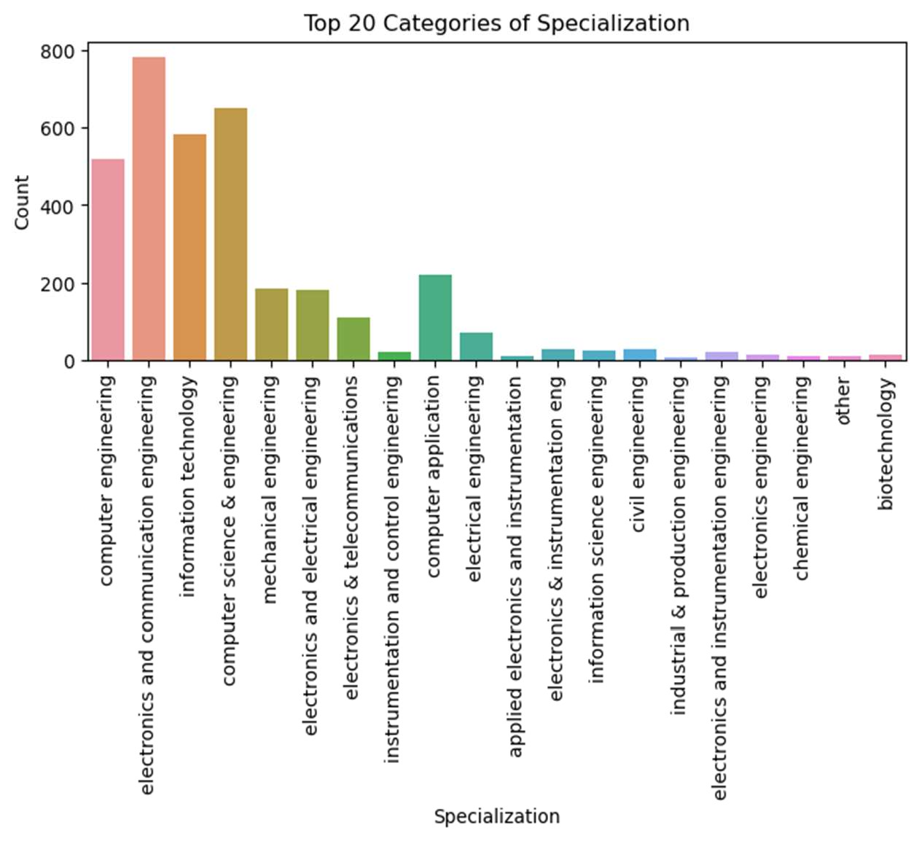
The top 20 degree plot reveals that B.Tech/BE boasts the highest count, while M.Sc. (Tech) exhibits the lowest count.
Among specializations, electronics and communication engineering, along with computer science & engineering, show the highest counts.
Conversely, the specializations with the lowest counts include chemical engineering, industrial & production engineering, and other disciplines.

Slide 12
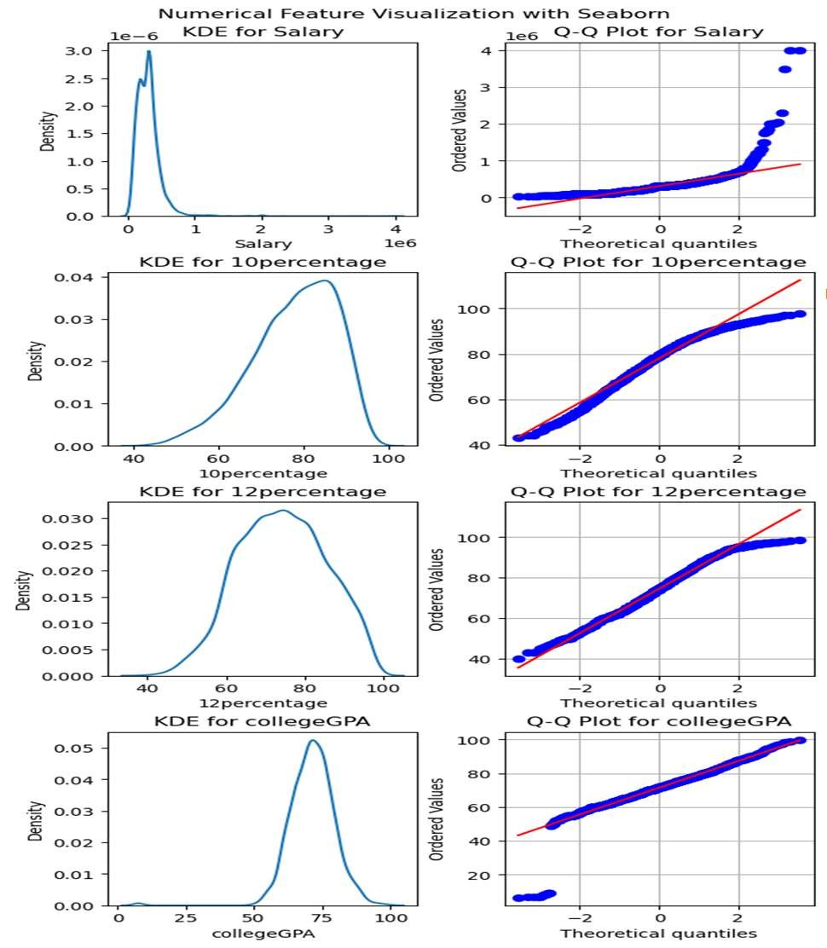
Univariate - Numerical Analysis
Salary:
Shapiro-Wilk test indicates a significant departure from normality (p < 0.05), suggesting the distribution is likely not Gaussian.
The visualization reveals potential outliers with salaries significantly higher
than the median, indicating possible high-income earners.
10percentage:
Shapiro-Wilk test shows a significant departure from normality (p < 0.05), indicating a non-Gaussian distribution.
Histogram suggests a skewed distribution, potentially indicating variations in academic performance among students.
12percentage:
Shapiro-Wilk test demonstrates a significant deviation from normality (p < 0.05), implying a non-Gaussian distribution.
Bimodal distribution observed in the histogram indicates the presence of
two distinct peaks, suggesting differences in academic performance among students.
collegeGPA:
Shapiro-Wilk test reveals a significant departure from normality (p < 0.05), indicating a non-Gaussian distribution.
Probability plot deviations from the diagonal line suggest departures from normality, implying the distribution may not follow a perfect normal distribution.

Slide 13
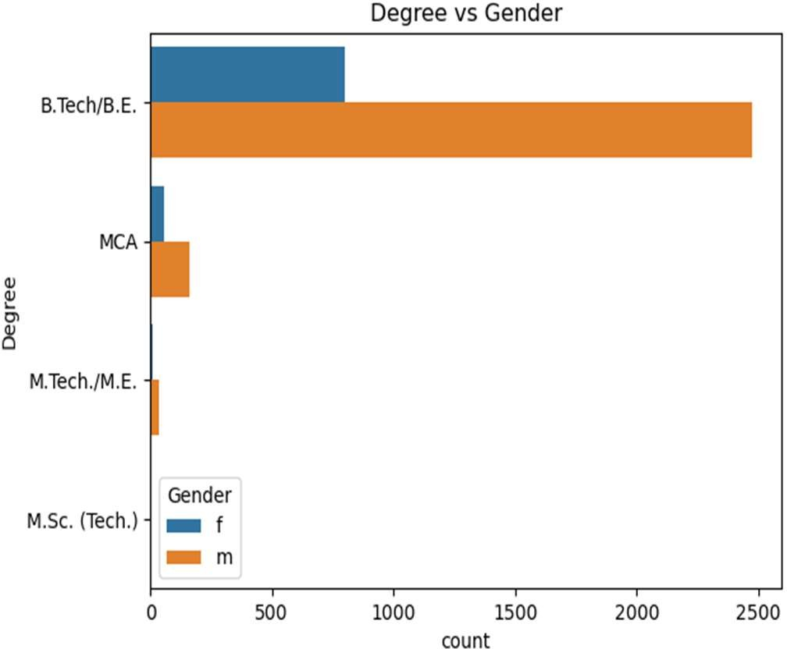
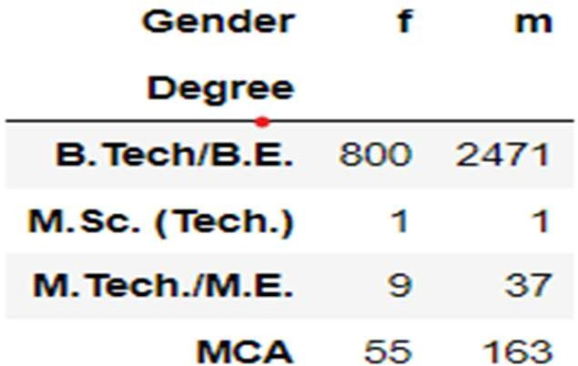
Bivariate Analysis - Categorical vs Categorical
The highest number of males and females hold a degree in B.Tech/BE compared to other degrees.
The chi-square statistic is 2.172 with a p-value of 0.538. At the 0.05 significance level, the null hypothesis (H0) is not rejected.
Thus, there is insufficient evidence to suggest a relationship between individuals' degree and gender.

Slide 14
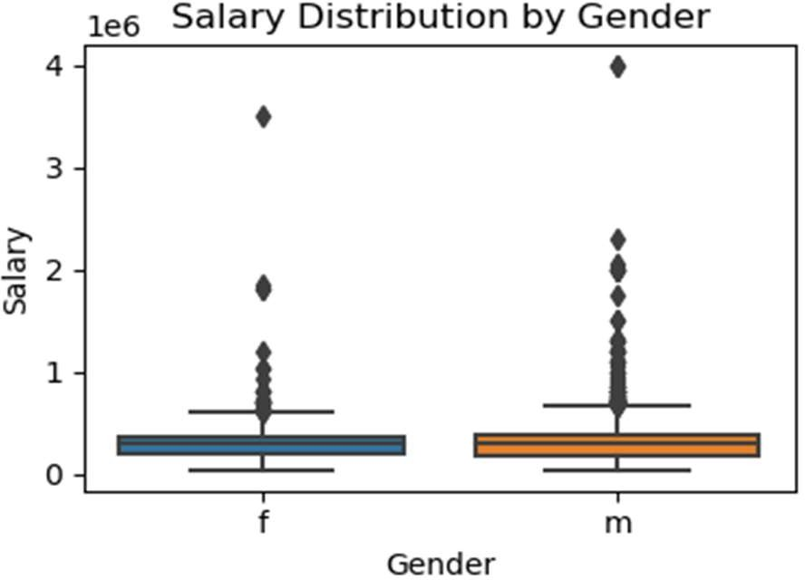
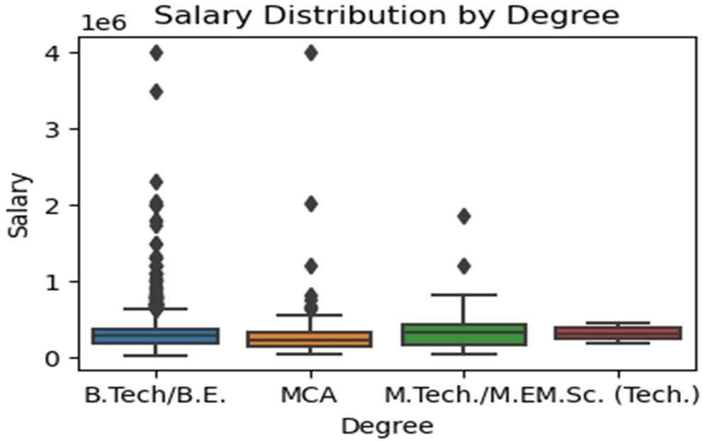
Bivariate Analysis - Categorical vs Categorical
The salary distribution by degree plot indicates that the highest amount of salary is observed for individuals with B.Tech/BE and MCA degrees, with a predominant range of 400,000/Annum, compared to other degrees.
The 25th, 50th (median), and 75th percentiles of the salary distribution across all degrees show approximately equal values, ranging from
0.3 to 0.5.
The salary distribution by gender reveals that the highest salaries are found among males, with a peak in the 400,000 range, compared to females.
The mean salary is approximately equal for both males and females.

Slide 15
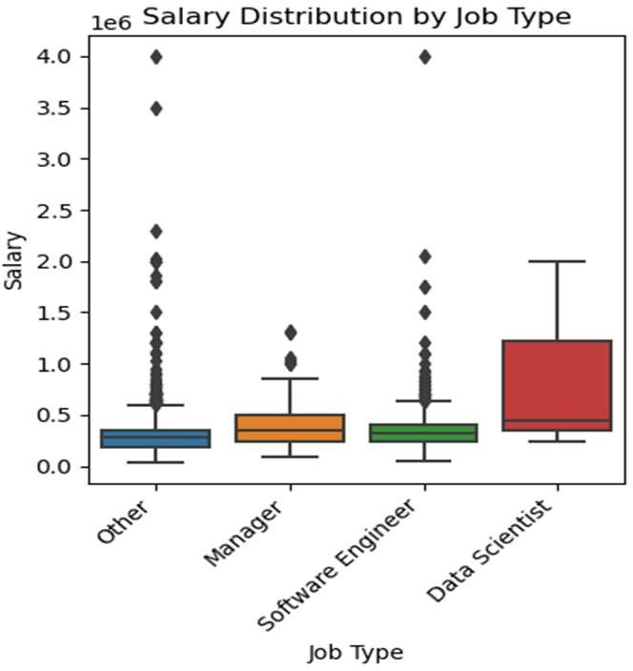
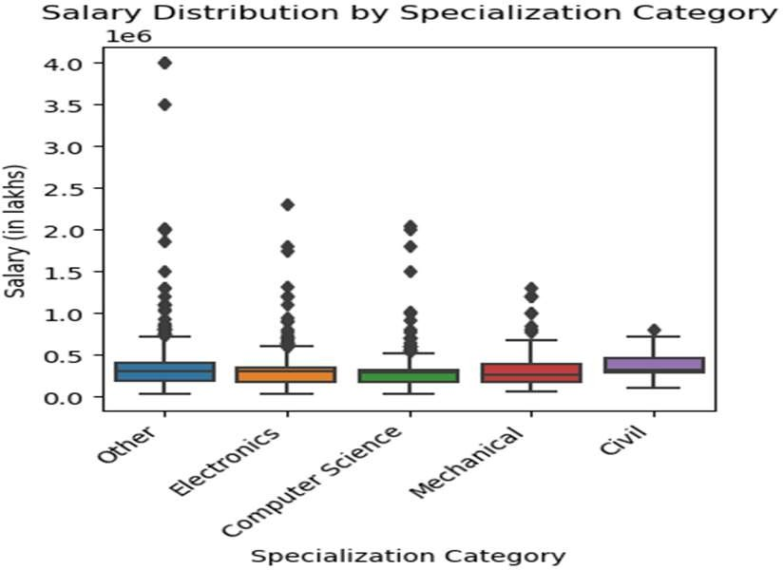
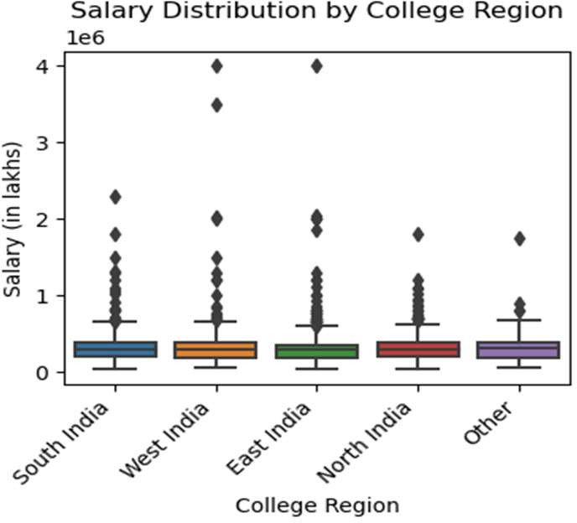
Salary Distribution by Job Type:Data Scientists:
Salary Distribution by Specialization:
Mean salaries across specializations are approximately equal.
The maximum salary is observed in the "Other"
specialization, surpassing those in Electronics, Computer Science, Mechanical, and Civil.
Highest Salary Range: 2.0
Mean Salary: 0.5
75th Percentile: 1.0
No outliers observed
Salary Distribution by College Region:
Other Job Types & Software Engineers:
Highest Salary Range: Up to 4.0 (with outliers)
Mean Salary: Typically in the range of 0 to 0.5
75th Percentile: Around 0.4
West India and East India exhibit the highest salaries compared to other regions.
Mean salaries remain consistent across all regions.

Slide 16
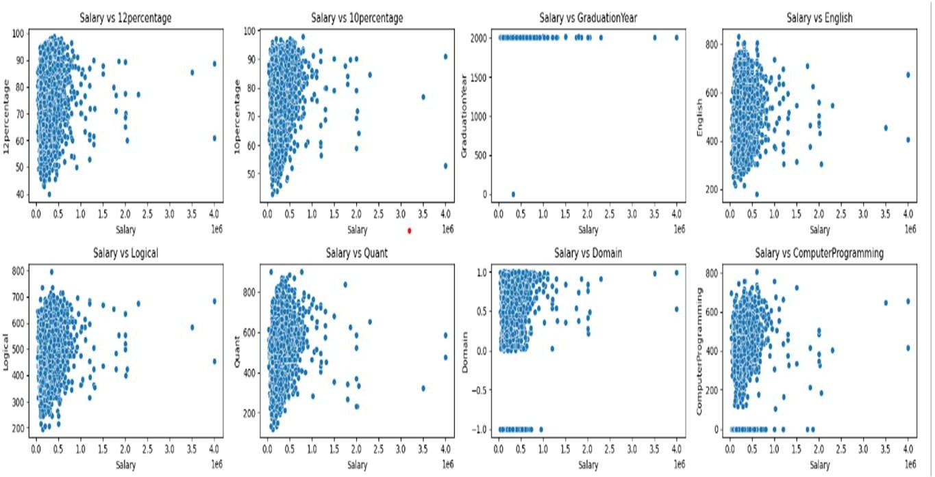
Bivariate Analysis - Numerical vs Numerical
Positive Linear Relationships:
'Salary' exhibits statistically significant positive linear relationships with:
'college GPA', '12percentage', '10percentage', 'English',
'Logical', 'Quant', 'Domain', 'Computer Programming', 'Civil Engg', 'conscientiousness', 'agreeableness', and 'nueroticism'.
Higher values in these columns tend to correspond to higher salaries.
No Significant Linear Relationships:
'Salary' does not show statistically significant linear relationships with:
'Graduation Year’, 'Electronics And Semicon', 'Mechanical Engg', 'Telecom Engg', 'extraversion', and 'openness to experience'.
Salary does not notably vary based on these factors.
Negative Linear Relationships:
'Salary' exhibits statistically significant negative linear relationships with:
'Electrical Engg'.
Higher values in this column tend to correspond to lower salaries.

Slide 17
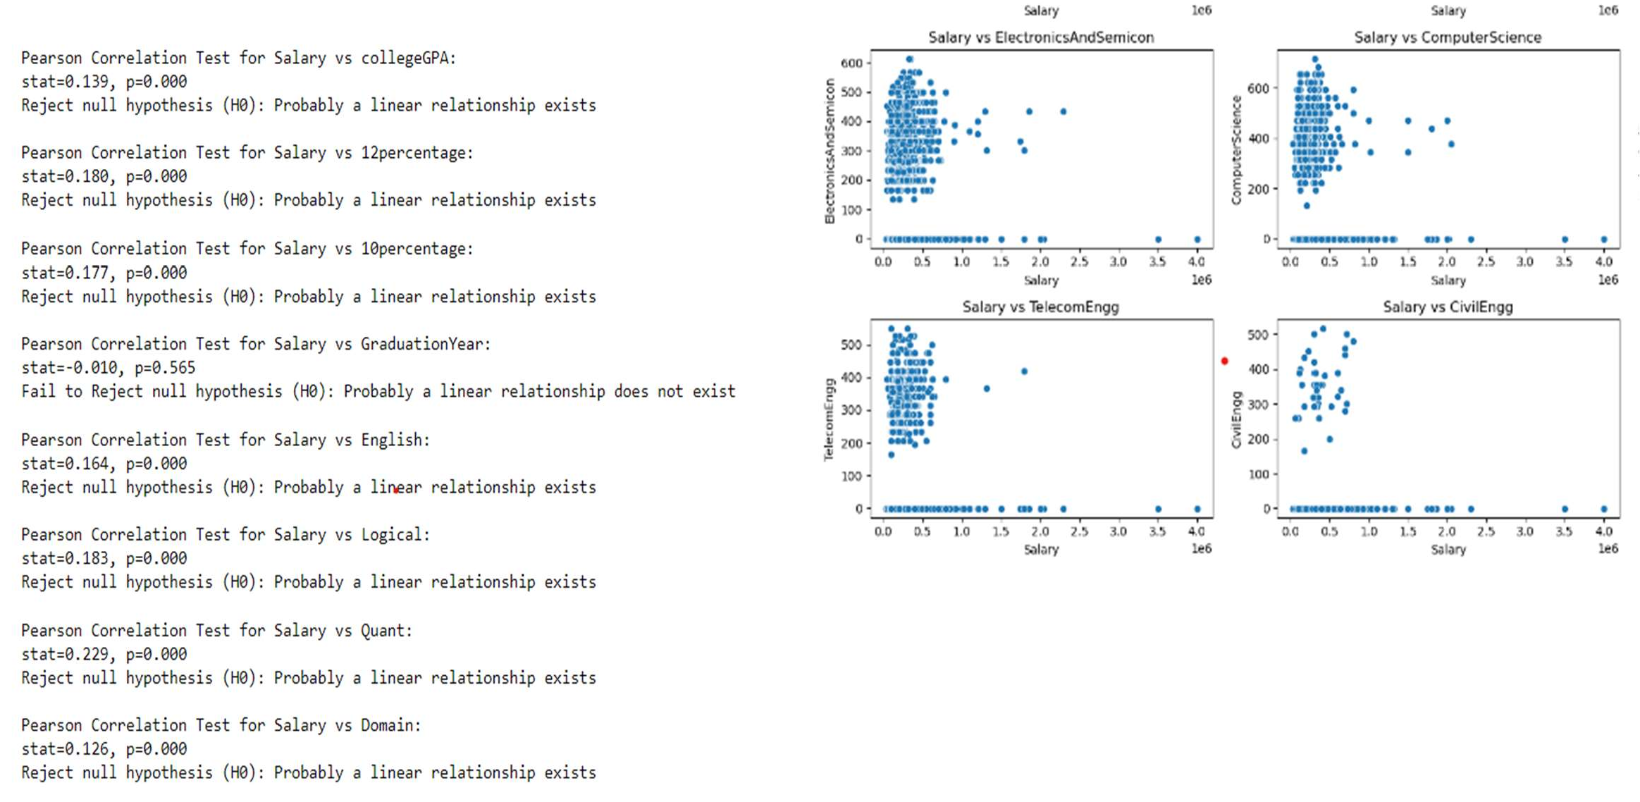

Slide 18
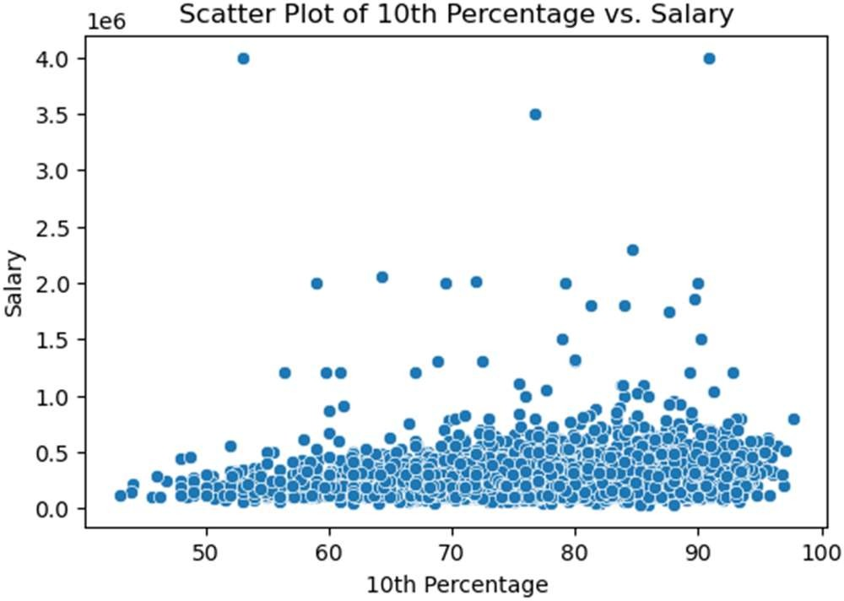
Research Questions
Research Question 1: Correlation between academic performance and salary
Correlation between academic performance and salary:
The scatter plot of 10th percentage versus salary indicates a potential positive correlation between academic performance in the 10th grade and salary levels.
As the 10th percentage increases, there seems to be a trend of higher salaries, suggesting that individuals with better performance in their 10th grade examinations may earn higher salaries.

Slide 19
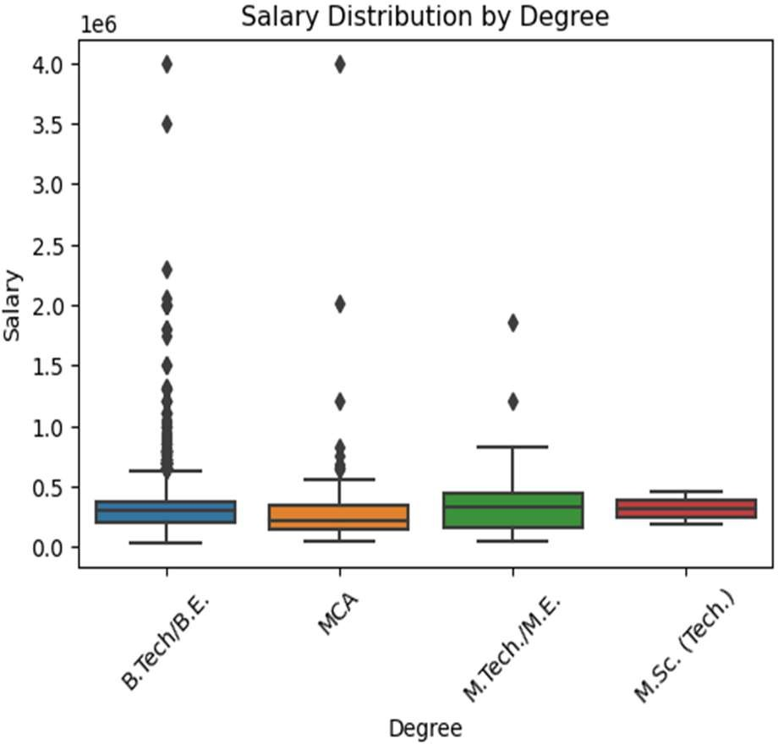
Research Question 2: Salary distributions across different educational degrees
OBSERVATION OF Salary Distribution by Degree:
The plot shows that individuals with degrees in B.Tech/BE and MCA tend to have higher salaries compared to other degrees.
It indicates a potential correlation between educational qualification and salary level, with B.Tech/BE and MCA leading in terms of salary distribution.

Slide 20
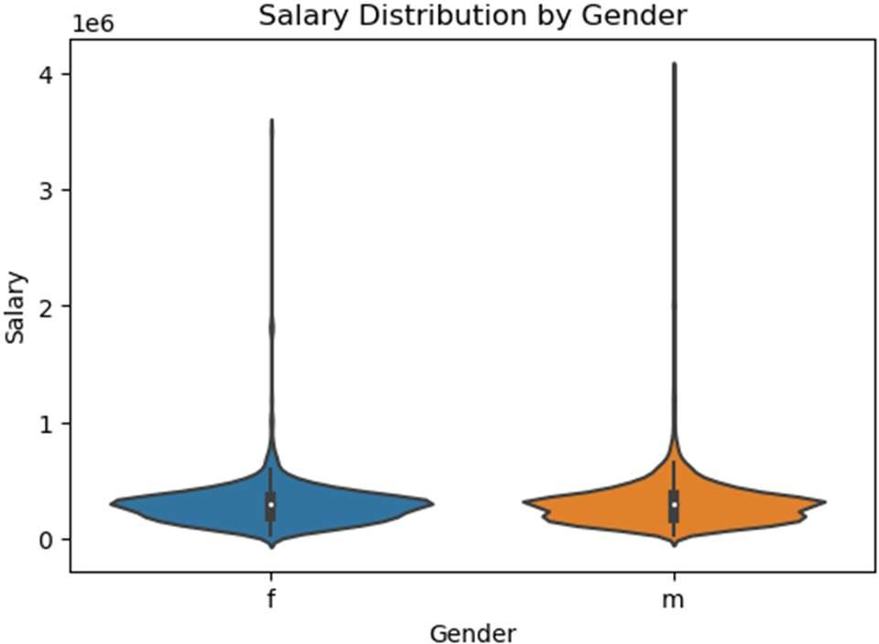
Research Question 3: Impact of gender on salary levels
OBSERVATION OF Salary Distribution by Gender:
The plot suggests that males generally have higher salaries compared to females, as the highest salary range is more prominent for males.
This highlights potential gender disparities in salary levels, warranting further investigation into factors contributing to this gap.

Slide 21
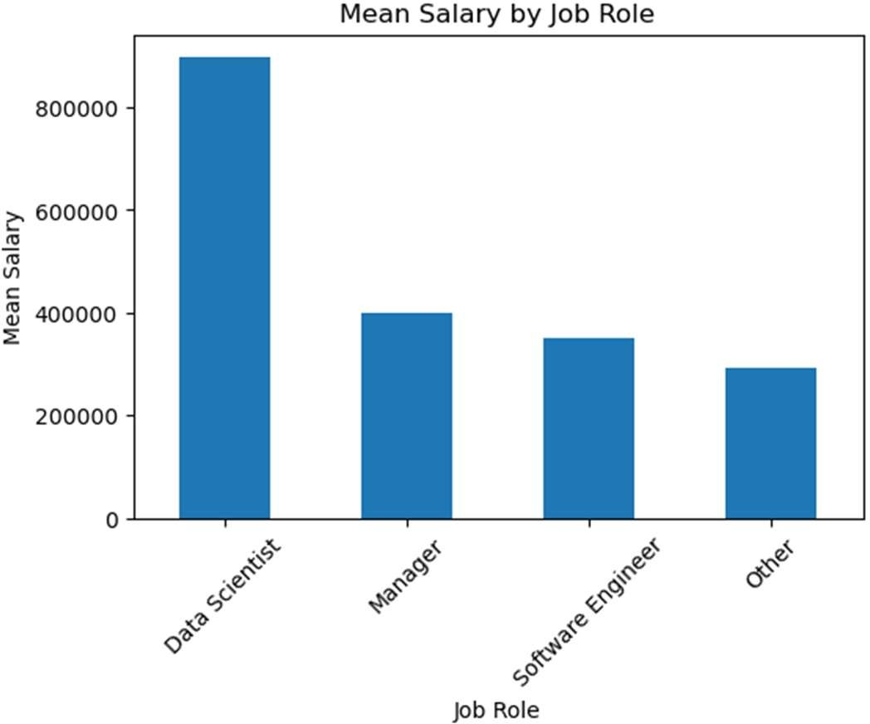
Research Question 4: Salary distributions across different job roles
OBSERVATION OF Salary Distribution by Job Type:
Data Scientists appear to have the highest salary range, indicating the demand and premium associated with this role.
The presence of outliers in other job types suggests variability in salary levels within those roles, possibly due to factors like experience, skills, or industry.

Slide 22
Conclusion
Degree and Gender Distribution:
B.Tech/BE is the most common degree for both males and females.
The chi-square test suggests no significant relationship between degree and gender.
Salary Distribution:
The highest salaries are typically observed for B.Tech/BE and MCA graduates, with outliers indicating exceptionally high earners.
Salary distributions by gender show comparable median salaries, but males tend to have higher maximum salaries.
Data scientists command the highest salaries, with other job types also exhibiting high maximum salaries but with outliers.
Academic Performance:
Academic performance metrics such as 10th, 12th percentages, and college GPA demonstrate non-Gaussian distributions, with significant departures from normality.
Variations in academic performance are evident, indicated by skewed distributions and bimodal patterns.
Specialization and College Region Impact:
While mean salaries are consistent across different specializations and regions, outliers contribute to variations in maximum salaries.
West India and East India regions exhibit higher salaries compared to others, suggesting regional impacts on salary trends.
Overall Implications:
The analysis provides insights into the distribution of salaries, academic performance, and their relationships with degrees, gender, specializations, and regions.
These findings can inform strategic decisions for individuals, educational institutions, and employers in understanding and navigating the job market landscape.

Slide 23
THANK YOU

